Slide 1


Amin Nadimy
- 1D-DG Petrov-Galerkin FEM
- Fortran
ICL-ICAM-BP Meeting
13th November 2020

Slide 2
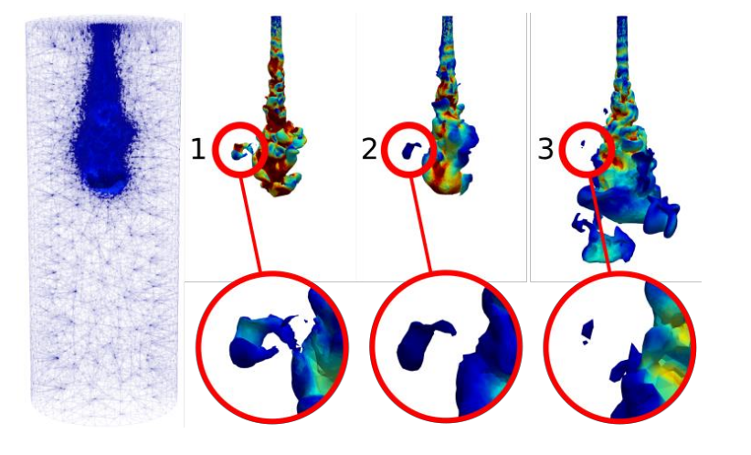
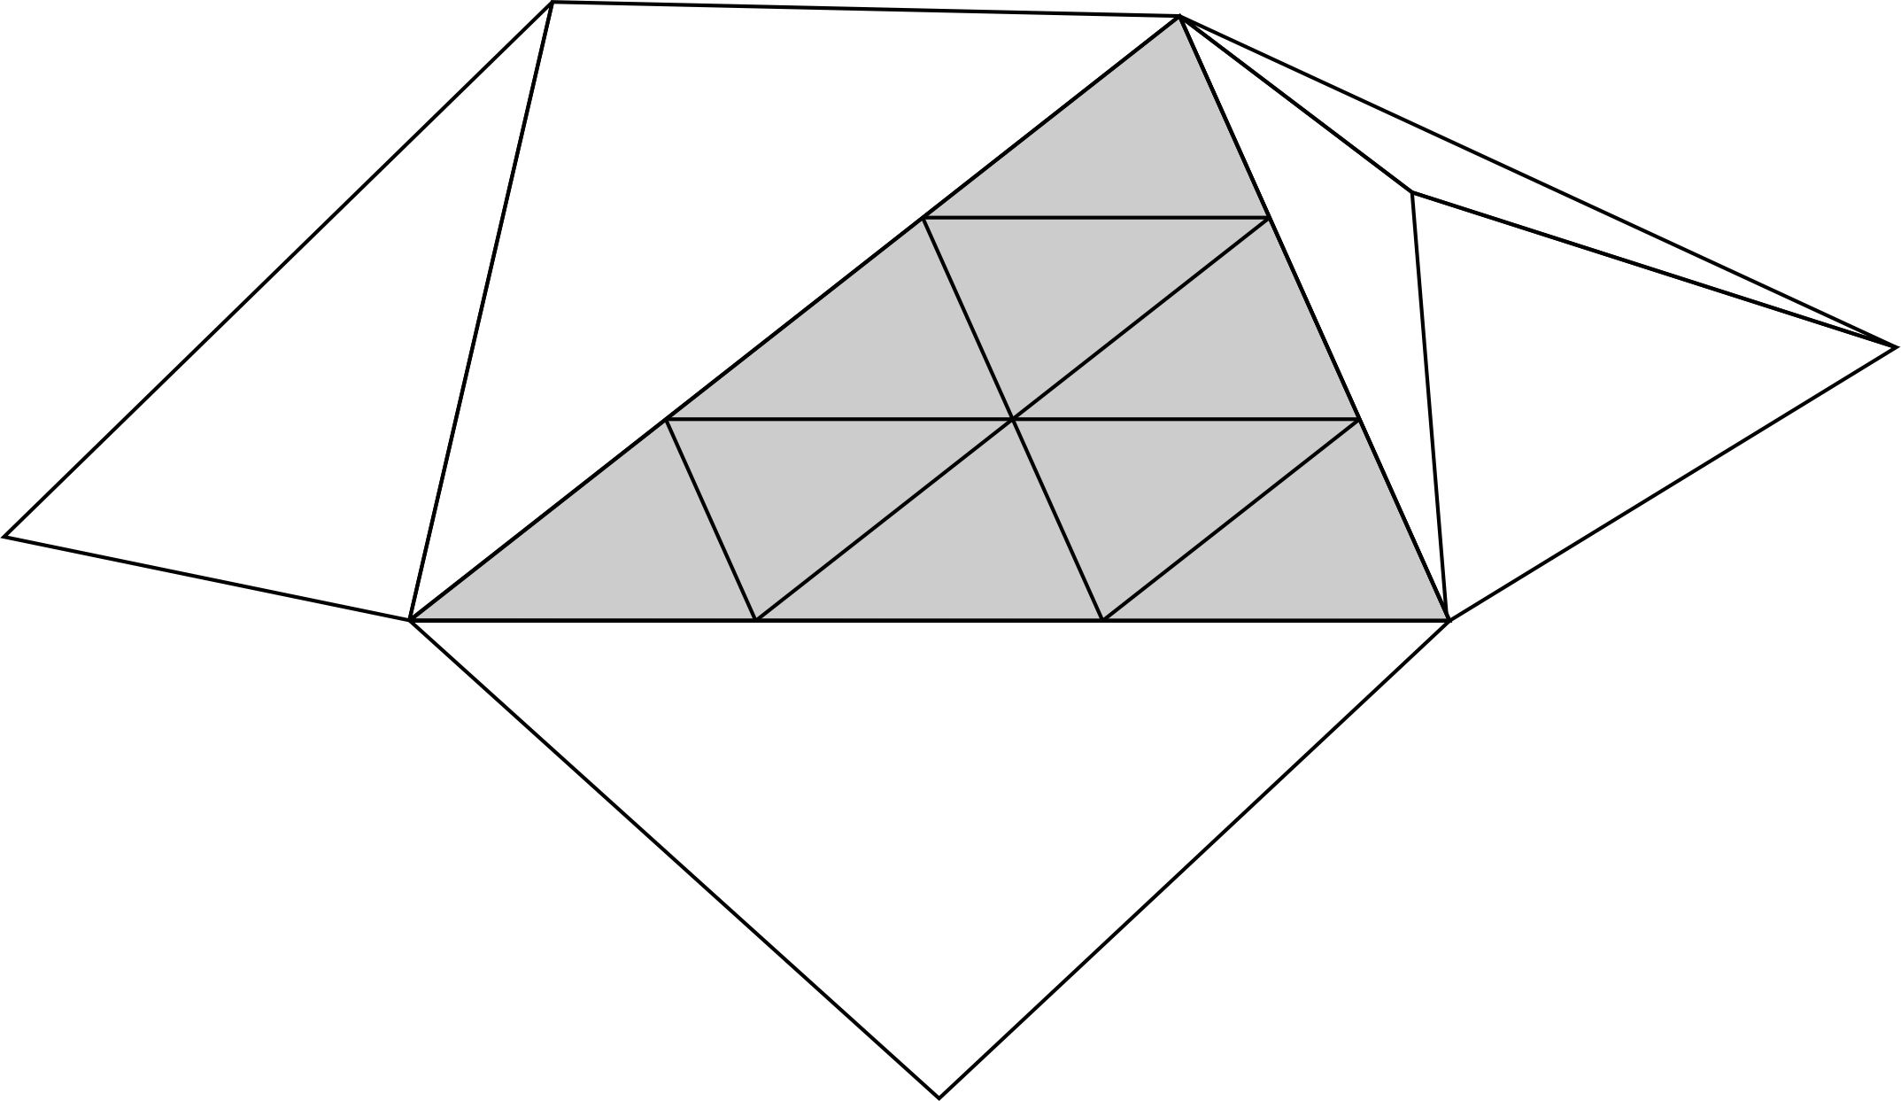

PhD project
Dynamic semi-structured meshes for fast numerical simulation of Multi-Phase Modelling in the energy industry
Figure 1. Semi-structured mesh
Figure 2. Creation and dispersion of a droplet
Supervisors:
Professor C. C. Pain, Dr P. Salinas, Dr A. I. Obeysekara and Dr A. Nicolle (BP)
Applied Modelling and Computational Group, Department of Earth Science and Engineering
ICL-ICAM-BP Meeting
13th November 2020

Slide 3
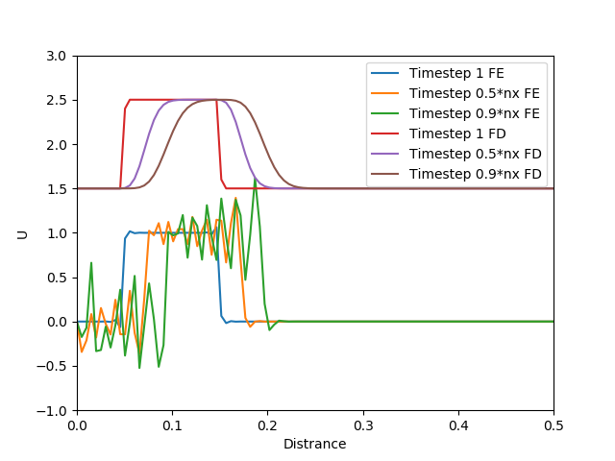
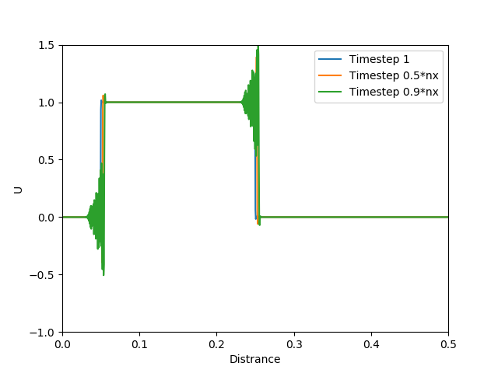
My progress
Week 1 (03 October 2020)
1D 1st order square wave using Finite Difference Method (FDM)
Mathematical formulations in LaTex
Implementation in Python
Week 2
The same problem in Finite Volume Method (FVM)
Week 3 - present
Studying the same problem
using CG and DG Finite Element Method (FEM)
Figure 3. Number of time steps=100, number of elements=100, Courant Number=0.1, velocity=0.1
Figure 4. Number of time steps=100, number of elements=1000, Courant Number=0.1
ICL-ICAM-BP Meeting
13th November 2020

Slide 4
Regular weekly meetings
AMCG catch-up
BP catch-up
Brainstorming CFD code optimization
Porous media/Inertia
Extra courses and trainings
•Introduction to Python
•Introduction to Fortran
•HPC
•GTA training
•LaTex
•Using Git to Code and Share
•The Linux Command Line for Scientific Computing
Near-future work
2D 1st order square wave in FDM, FVM and FEM
semi-structured 2D DG FEM.
I will work with Prof. Pain and others on the Fortan code for semi-structured and with space-time within ICFERST/FLUIDITY.
ICL-ICAM-BP Meeting
13th November 2020

Slide 5
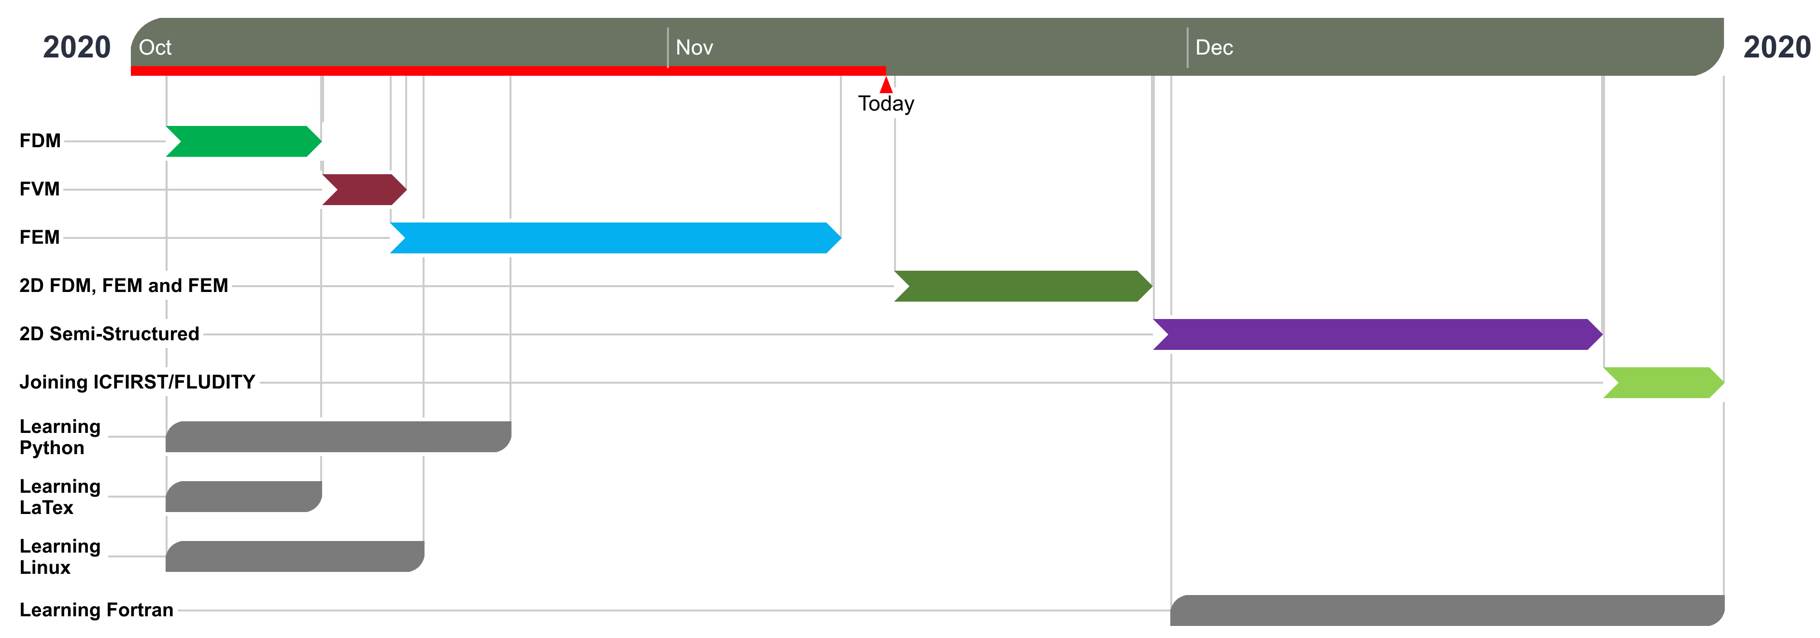
Future work
Figure 5. Work plan from October to December 2020.
ICL-ICAM-BP Meeting
13th November 2020

